Slide 1
Advanced robotics, artificial intelligence and the automation of tasks: definitions, uses, policies and strategies and occupational safety and health

Slide 2
Introduction
A four-year research programme "OSH overview on digitalisation“ started in 2020.
The goals were:
Develop and disseminate information on risks, challenges and opportunities for OSH associated with digitalisation.
Main topics under research were the OSH implications on:
Advanced robotics and AI-based systems for automation of tasks.
New forms of worker management through AI-based systems.
Online platform work.
New systems for the monitoring of workers’ safety and health.
Remote and virtual work.

Slide 3
Introduction: Objectives
Carry out an overview of policies, research and practices in relation to advanced robotics and AI-based systems for the automation of physical and cognitive tasks and to assess their implications for OSH.
Examine the potential consequences for workers’ safety and health and identify the main risks, challenges and opportunities for prevention, policy and practice.
10 case studies to be developed following the field research.

Slide 4
Introduction: Definitions
Automation can be defined as “a device or system that accomplishes (partially or fully) a function that was previously, or conceivably could be, carried out (partially or fully) by a human” (Parasuraman et al., 2000).
Advanced robotics
Smart ICT
Cobots
Industrial robots
Service robots
Transportation robots
Educational robots
Construction robots
…
Artificial Intelligence software
Machine Learning
Cloud Computing
Augmented Reality
Deep Learning
…

Slide 5
Introduction: Definitions
Artificial intelligence (AI) refers to systems that display intelligent behaviour by analysing their environment and taking actions – with some degree of autonomy – to achieve specific goals. AI-based systems can be purely software-based, acting in the virtual world (e.g. voice assistants, image analysis software, search engines, speech and face recognition systems) or AI can be embedded in hardware devices (e.g. advanced robots, autonomous cars, drones or Internet of Things applications). EU Commission High-Level Expert Group*
*https://digital-strategy.ec.europa.eu/en/library/definition-artificial-intelligence-main-capabilities-and-scientific-disciplines

Slide 6
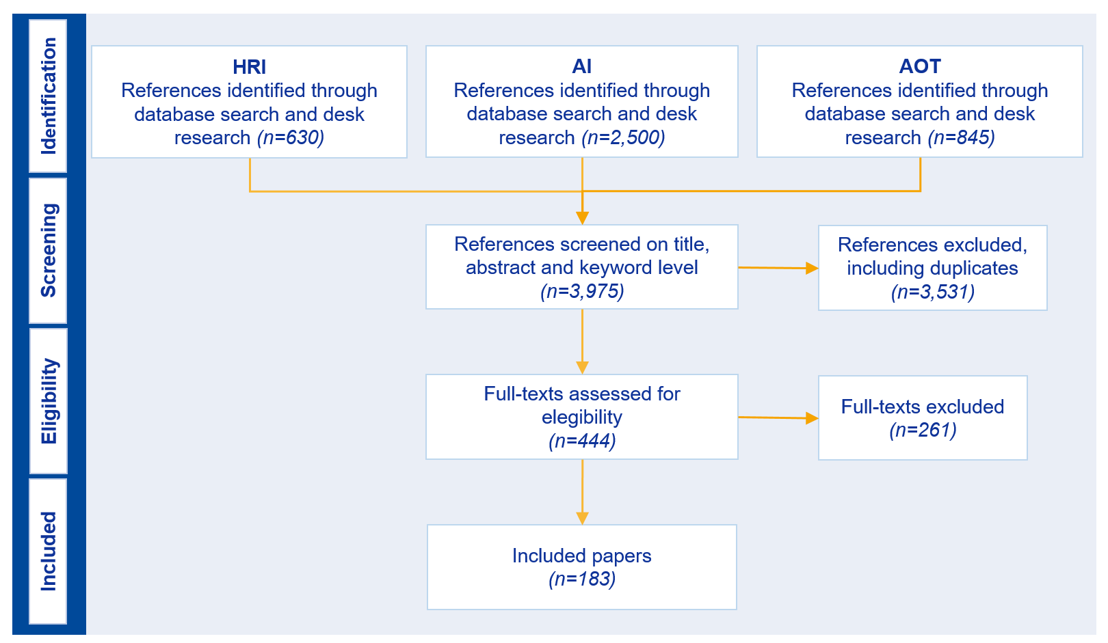
Methodology: Literature research

Slide 7
Methodology: Task approach
Advanced robotics and smart ICT expand in their capabilities, autonomy and flexibility.
Analyzing only the technology would not provide the most in-depth understanding of the application range and impact the technology can have.
“Tasks are a better unit of analysis when investigating the impact of automation potential. The task approach allows a more nuanced and detailed understanding of which specific aspects of human work can be more easily automated”. (Bisello et al., 2019, p. 3)
Based on a literature review of several task related frameworks, a specialised taxonomy for advanced robotics and AI-based system was developed.

Slide 8
Methodology : Task approach
Based on literature research: tasks can be categorised into object-related, person-related and information-related tasks.
Within these three categories, the tasks can also be divided into physical and cognitive tasks.
In their working context, tasks can also be fully or semi-automated.
With task automation through AI-based systems, there is a strong tendency towards cognitive automation.

Slide 9
Taxonomy: To assess AI-based systems and OSH
Beyond the task automated by AI-based systems or advanced robotics, their characteristics play a vital role in understanding their range and impact in the workplace.
Levels and factors of the taxonomy:
Each of these factors has multiple expressions.
This taxonomy enables assessment of AI-based systems and advanced robotics across jobs, sectors and tasks.
The reviewed literature was classified using the developed taxonomy.
Frontend (device)
Backend (software)
Type of task
Task characteristics
Degree of automation (semi/full)
OSH dimension

Slide 10
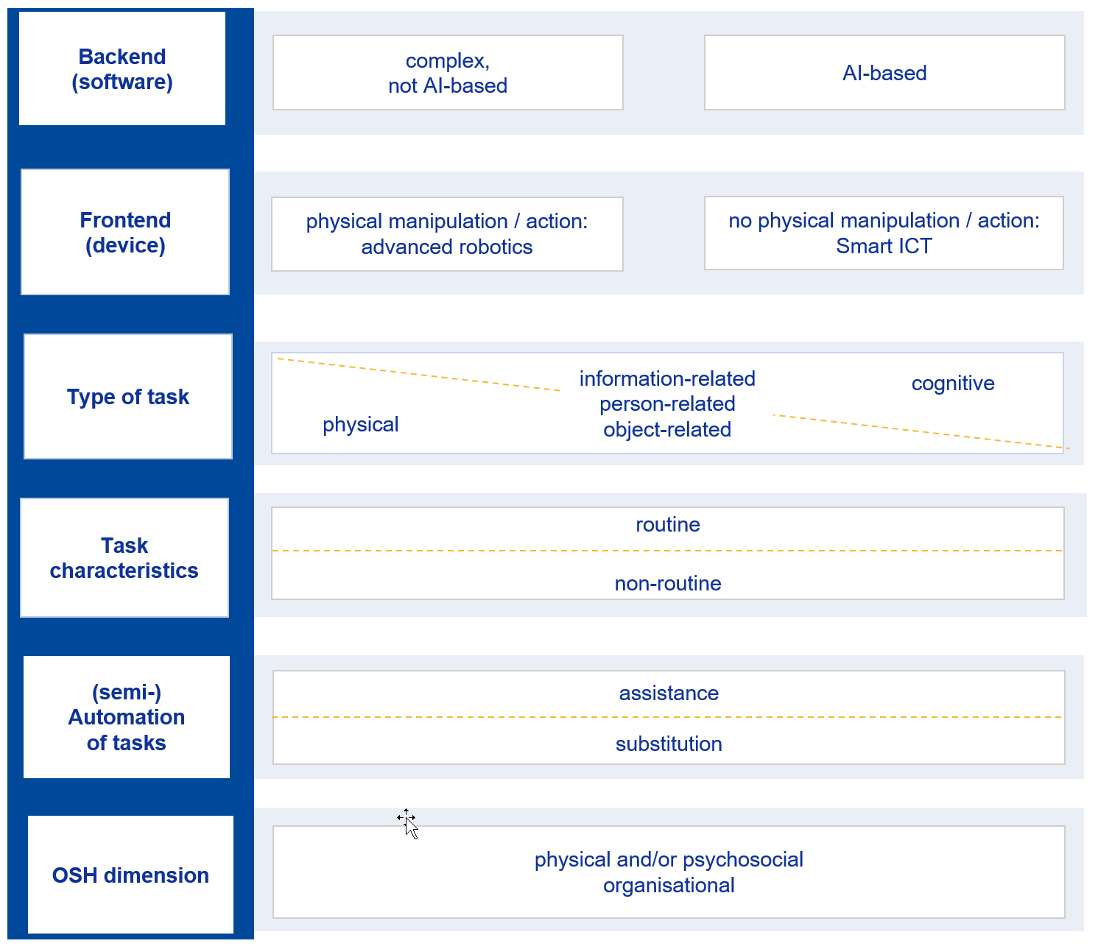
Taxonomy for AI-based systems and advanced robotics for the automation of tasks

Slide 11
Mapping of current and potential uses: Automation of cognitive tasks
NACE sector distribution
according to scientific literature
*Administrative and Support Service Activities and Information and Communication
were additionally highlighted by the FOP consultation

Slide 12
Mapping of uses: Distribution of technologies for cognitive tasks
AI-based systems commonly fall under one of four categories:
Automated software (learning applications, software testing, clinical information systems, etc.).
Decision support systems (especially prevalent in the medical field, finance, etc.).
Natural language processing.
AI-based analytical tools.
Robotic systems for the automation of cognitive tasks most commonly are:
Educational and social robots.
Telepresence robots.
Service robots.
Future uses:
Enhanced neural networks and other AI techniques for a variety of tasks (e.g. data processing and analysis).
Internet of things (IoT) - Interconnection of devices and systems.

Slide 13
Impact on jobs (tasks)
When it comes to the impact the technology will have on both tasks and therefore the jobs that contain these tasks, we see differences between the areas of application.
Examples:
Medical Diagnosis via Decision Support Systems:
Tasks, such as X-ray analysis can be fully automated.
However, the system will always be paired with a human radiologist.
The technology only replaces parts of a task.
Learning and teaching support:
Especially learning tasks require adaptable systems with high predictive capacities.
So far, they assist teachers by freeing up time to focus on the students.
Language and text processing:
A number of AI-based systems capable of textual content creation, speech production or even real-time language production like translation has increased.

Slide 14
Mapping of current and potential uses: Automation of physical tasks
NACE sector distribution
according to scientific literature

Slide 15
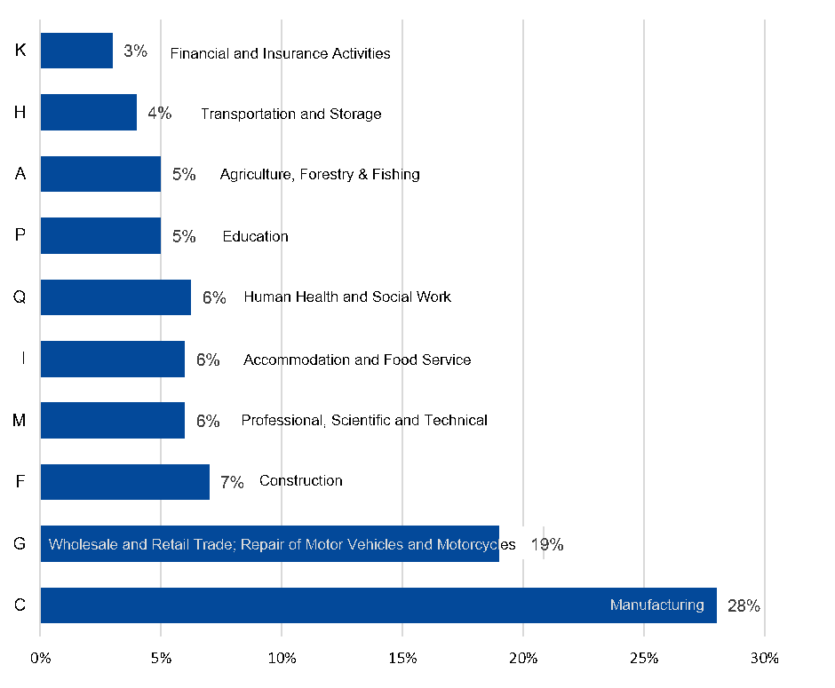
Mapping of current and potential uses: Automation of physical tasks
NACE (v. 2) code of enterprises with HRI according to ESENER-3.
According to ESENER-3 there is a stronger robotic presence in the Manufacturing sector.
Human Health and Social Work is a lesser. impacted sector
One possible explanation is a publication bias within scientific literature.

Slide 16
Mapping of uses: Distribution of technologies
A range of technologies have shown heightened prevalence in literature for the automation of physical tasks.
Robotic systems:
Industrial robot.
Collaborative robots (cobots) are mentioned as a subgroup of industrial robots.
Teleoperation robots.
Construction robots.
Medical robots.
Mobile/ transportation robots.
Autonomous robots for inspection.

Slide 17
Impact on jobs (tasks)
Advanced robotic systems are likely to eliminate specific tasks, as opposed to entire occupations outright (more task-related impact).
Currently, robotic systems are considered routine-biased (mainly performing routine-manual tasks).
Examples:
Lifting (of objects or people):
This task occurs in many different areas (e.g. medicine, manufacturing and construction).
Independent of the area of application, this reduces physical strain on the worker.
Transporting:
Warehouses, hospitals and offices provide a number of opportunities to automate transport tasks.
Cleaning.
Inspections.

Slide 18
Impact on jobs (tasks)
The impacted jobs have been found to be skill-biased (more specialised but overall, less complex skills)
Increased productivity of high-skilled workers while lowering demand for low-skilled workers
Technological advancement pushes workers without technical skills from middle-skill jobs into low-skill jobs
Middle-skill jobs, (i.e. cognitively and physically routine tasks in traditional manufacturing, transportation services and office staff), are more easily automated because they follow repetitive, finite procedures that can be carried out by robotic systems
Most experts see tasks that are repetitive, routine and less complex as the most likely candidates to be automated
Future uses:
Self-driving robotic systems (e.g. cars, drones, used in mail delivery)
Robot-as-a-Service (RaaS): new kind of business model / leasing a robot instead of purchasing it

Slide 19
Policies, strategies and programmes
There are several relevant legally binding regulations on European and national level as well as not legally binding initiatives and programmes on AI-based systems, advanced robotics and OSH.
All major European OSH relevant stakeholders present some strategy or initiative in relation to artificial intelligence and the potential impact on workplaces.
Most show similarities and shared values:
system transparency
technical robustness
respect of human rights, diversity and non-discrimination
data privacy and data governance
accountability
human-centred approach
participation of workers in the process

Slide 20
Policies, strategies and programmes: Regulation in Europe
Within Europe there are currently two main Directives that apply to technology and workplaces and therefore play a fundamental role in building the legislative basis for AI-based systems and advanced robotics:
Machinery Regulation 2023/1230/EU (that replaced Machinery Directive 2006/42/EC)
OSH Framework Directive 89/391/EEC
In 2021, the European Commission launched an additional legislative horizontal regulatory proposal: a proposal for the Artificial Intelligence Act.

Slide 21
Policies, strategies and programmes
EU Commission “Ethics guidelines for trustworthy AI” (2021):
Human agency and oversight […]
Technical robustness and safety […]
Privacy and data governance […]
Transparency […]
Diversity, non-discrimination and fairness […]
Societal and environmental wellbeing […]
Accountability […]

Slide 22
Policies, strategies and programmes
European Social Partners Framework Agreement on Digitalisation (2020):
AI systems should follow the human in control principle.
AI systems should be safe, i.e. should prevent harm.
AI systems should follow the principles of fairness.
AI systems need to be transparent and explicable with effective oversight.

Slide 23
Policies, strategies and programmes: Gaps and needs
The responses collected through the FOPs do not highlight any particular needs or gaps in relation to regulation on a European level in terms of worker protection.
Especially the OSH Framework Directive 89/391/EEC is labelled positively.
All new hazards and risks are properly covered in the Machinery Directive 2006/42/EC in relation with workplace equipment.
Some of the experts do describe the lack of a more global perspective which takes into account the deployment of AI-based systems in industry sectors.
Some say the greater issue is the lack of proper implementation and enforcement of the Machinery Directive:
Legislation can only be effective when applied properly.

Slide 24
Policies, strategies and programmes: National level
Based on the answers from the FOP consultation, important national regulations were identified.
Several countries are in the process of discussing legislation:
Austria reports discussion regarding advanced robotics that could result in a national legally binding (international) standard.
The Netherlands reports that in terms of smart robotics there are many (mandatory) discussion platforms deriving from the Machine Directive for inspectors, for industry partners, for standardization bureaus, etc.
Finland reports that data handling in relation to smart ICT is being included in preparation for many legislative updates, but on a more general level.

Slide 25
Policies, strategies and programmes: National level
Sweden’s Ministry of Enterprise and Innovation outlined a set of conditions that should shape the development of national policies around AI in their 2019 Report “National Approach to Artificial Intelligence”.
Focus on education and training to use AI-based systems.
Sectoral social partner’s initiatives and especially guidelines are also named by most countries:
Austria mentions 20 brochures on different topics of digitalisation within the programme “Work New 4.0”.
Finland names the “AI Ethics Challenge” initiative – a challenge for companies to take part in discussing what the ethical rules for using AI are, aiming at collecting ethical guidelines.
France reports a prevention guide for manufacturers and users for the implementation of collaborative robot applications.

Slide 26
Policies, strategies and programmes: National level
Germany reports campaigns on advanced robotics and smart ICT and their use in the workplace as being part of the AI strategy as well as the “HighTech strategy 2025” of the German government .
Ireland’s National Standards Authority (NSAI) is working on ISO/TC299 “Developing Safety Standards for Robotics”.
Portugal reports the national government program “Digital Transition Action Plan” and the following publications: “Human-Centred Approach for the Design of a Collaborative Robotics Workstation”.

Slide 27
Policies, strategies and programmes: National level
There are also recommendations given by major stakeholders in some countries:
Austria with "AIM AT 2030 - Artificial Intelligence Mission Austria 2030" by Federal Ministry Republic of Austria Digital and Economic Affairs.
Finland names ministries, such as the Ministry of Social Affairs and Health and the Ministry of Economic Affairs and Employment and the Ministry of Finance as sources for specific recommendations.
The Netherlands name state recommendations on smart ICT and privacy given by the Ministry of Social Affairs and Employment (SZW) through worker protection legislation and the Ministry of Economic Affairs and Climate Policy (EZ).
Germany states that when implementing Human Robot Interactions (HRI) into workplaces, recommendations are given by the German Institute for Occupational Safety and Health of the German Social Accident Insurance.

Slide 28
Policies, strategies and programmes: Gaps and needs
Regarding gaps and needs on a national level, the answers from the FOP consultation indicate that many countries seem to be missing national activities on a more tangible level.
A number of countries report to be missing national legally binding regulation regarding the automation of physical and/or cognitive tasks through AI-based systems.
There is a gap between existing regulations and adequate application reported in some countries.
Ethical guidelines on national level are needed, regarding guaranteeing basic human rights and privacy of personal data handling.
According to the Netherlands, OSH is not debated enough in the context of new emerging technologies.

Slide 29
Policies, strategies and programmes: Summary
On a national level, nearly every country reports some form of not legally binding activity related to AI-based systems and advanced robotics.
Within the European countries, a vast number of sectoral programmes, social partner’s guidelines or recommendations given by major stakeholders or the state can be found.
Most countries also report to be missing activities (related to practical use and application for OSH).
On a more global level, there are large numbers of campaigns, actions, strategies and visions. As the issue becomes more specific, related to specific industries, jobs or tasks, the picture becomes blurry for example with regards to specific system or workplace design recommendations.
All relevant stakeholders consider that raising awareness is particularly important, and policy-makers can have an important role in bringing this to attention.

Slide 30
Thank you!
REPORT “Advanced robotics, artificial intelligence and the automation of tasks: definitions, uses, policies and strategies and Occupational Safety and Health”
BROCHURE “Digitalisation and OSH” (available in 19 languages)
POLICY BRIEF “Impact of AI on OSH”
POLICY BRIEF “Artificial intelligence, advanced robotics and the automation of tasks at work: taxonomy, policies and strategies in Europe”
More on Digitalisation and OSH at: https://osha.europa.eu/en/themes/digitalisation-work

