Slide 1
SAFE AND HEALTHY WORK IN THE DIGITAL AGE Healthy Workplaces Campaign 2023-25
Digital platform work: implications for occupational safety and health

Slide 2
Overview
Defining digital platform work
Taxonomy
Facts and figures
Opportunities
OSH risks and challenges
Mapping responses to OSH risks
Takeaways

Slide 3
Defining digital platform work
“All paid labour provided through, on or mediated by an online platform”
Online vs on-location digital platform work:
Tasks are always organised online, but can be performed virtually or in the physical world
Either online or on-location digital platform work
Uses algorithmic management
Usually has non-standard working arrangements
Notes:
Algorithmic management is used to allocate, monitor and evaluate the workers’ behaviour and performance.
With a prevalence of non-standard working arrangements, digital labour platforms tend to classify workers as self-employed in their terms and conditions, which results in the shifting of risks, liabilities and responsibilities, including the area of health and safety, onto digital platform workers.

Slide 4
Taxonomy
Dimensions | Type of digital platform work
 | Type 1 | Type 2 | Type 3 | Type 4
Format of labour provision | On-location | On-location | Online | Online
Skills level required to execute the tasks | Lower-skilled | Higher-skilled | Lower-skilled | Higher-skilled
Level of control exercised by the digital labour platform | High level of control | Moderate level of control | High level of control | Low level of control
EXAMPLE | Parcel delivery | Handiwork | Online content review | Remote programming
Notes:
Based on a review of the existing literature, a taxonomy was developed that relies on three dimensions and results in four types of digital platform work as shown in the table. The three dimensions are:
Dimension 1: The format of labour provision (online or on-location)
Online platform work refers to tasks that are matched with workers online and are performed only or mostly virtually on an electronic device at any location, although the most common location is the worker’s home. On-location platform work refers to tasks that are carried out only or mostly in the physical world, either in public areas, on the road or at the client’s premises, even though the matching process of tasks with workers still happens online. This dimension is relevant since, from an OSH perspective, the physical environment determines to a large extent (but not exhaustively) which OSH risks digital platform workers are exposed to, as well as particular difficulties in how these risks are managed in practice.
Dimension 2: The skills level required (lower-skilled vs higher-skilled)
The skills level serves as a proxy for the nature, scale and complexity of the task. It determines whether a task can be allocated to anyone active on the platform or a selected individual. The level of skills required to execute a task does not reveal anything about the general skills a digital platform worker needs (e.g. strategies to find work) or has (e.g. education level). The scale of tasks ranges from micro tasks, e.g. click work, in which a single task takes only a few seconds, and medium tasks, e.g. parcel delivery, which takes a few minutes or hours of work, to larger tasks, e.g. fully-fledged projects that could take several weeks or months to complete, e.g. website design.
Dimension 3: The level of control exercised by the platform (cf. algorithmic management)
The ‘level of control’ is an umbrella term encapsulating several dimensions that classify digital platforms. It serves as an indicator of the extent of hierarchical power and managerial prerogatives a digital labour platform deploys in its relationship with workers, more specifically as it relates to (unilateral) decisions on work allocation, organisation and evaluation. Platforms’ intermediation can range from minimal to a very significant amount of control. This is important given that the level of control provides the notion of subordination, which in most Member States is the key legal criterion in the determination of employment status. In addition, at EU level and in most Member States, the OSH regulatory framework only applies to employees. This dimension is strongly linked to the reliance of most digital platforms on algorithmic management (and digital monitoring and surveillance) and the way it shapes working conditions and social protection in digital platform work. There is no uniform practice among platforms in the pervasiveness in which they deploy such techniques.

Slide 5
Facts and figures: workers by type of work and sector
6% of workers in the EU earned most or part of their income through a digital platform
Source: OSH Pulse 2022 - EU-OSHA
Supply of gas,
electricity and
water, mining and
quarrying
ICT,
Finance,
professional, scientific and
technical
services
Commerce,
transport,
accommodation
and food service
Administration,
incl. public
administration
and defense
Health and
social care
Social, cultural,
personal and
other
services
Construction
Manufacturing
and engineering
Education
Agriculture,
forestry and
fishing
Platform work
No platform work
Notes:
In 2022, in the 27 Member States + Iceland and Norway:
- About 6% of workers earned part of most of their income working for digital platforms.
- 6% of workers is more than 11.5 million people across the EU.
Digital platform work is more present in:
Information and communication technology, finance, professional, scientific or technical services (19,2%)
Commerce, transport, accommodation or food services (18,3%)
Administration and support services, including public administration and defence (15,8%)
OSH Pulse 2022: https://osha.europa.eu/en/facts-and-figures/osh-pulse-occupational-safety-and-health-post-pandemic-workplaces

Slide 6
Facts and figures: workers by type of work and worker characteristics
65 and more
Age of respondent
People aged 25-34 are the majority in platform work
Most platform workers are men
Prevalence of platform work higher among immigrants
Gender
Woman
Man
Nationality
Country citizen
Foreign citizen
No platform work
Platform work
Source: OSH Pulse 2022 - EU-OSHA
Notes:
OSH Pulse 2022: https://osha.europa.eu/en/facts-and-figures/osh-pulse-occupational-safety-and-health-post-pandemic-workplaces

Slide 7
Facts and figures: workforce diversity
Migrants and ethnic minorities
Overrepresented in lower-skilled on-location and online digital platform work
Motivations: earning an income, escaping informal work, part of ‘migration pathway’
Women
Digital platform work is becoming less gender-segregated
Persons with disability, chronic illness or condition
Involvement depends on nature of condition and task

Slide 8
Opportunities
Promotes labour market (re)entry and participation
Includes vulnerable and marginalised groups
Attractive income source
Develops skills
Provides experience to find better jobs
Enables choice of work environment
Reduces risks of violence and harassment
Notes:
The reduction of risks related to violence and harassment is due to the limited contact with platform, colleagues and clients.
Digital platform work can also help overcome negative perceptions or prejudice and be beneficial for individuals who struggle with social interactions.

Slide 9
OSH risks and challenges
Concentrated in occupations that are more dangerous
Often involves additional work
Its nature and work conditions aggravate OSH challenges and risks
Workers encounter physical and psychological health and safety risks, which are insufficiently prevented and managed
Notes:
Risks are similar to those related to the same tasks outside the platform economy, but digital platform work has some specific effects mentioned above.

Slide 10
Factors aggravating OSH risks and challenges
Unclear employment status and contract
Workers become responsible for their own safety and health
Algorithmic management
Concentrated power in the platform
Rewards or penalties based on workers’ performance
Lack of transparency of the algorithm
Reduced workers’ autonomy, job control and flexibility
Exhaustion, anxiety, stress
Notes:
Digital labour platforms tend to qualify digital platform workers as self-employed, which may not be in accordance with the factual conditions under which they work.
Self-employed are generally responsible for their own safety and health and the OSH legislation applicability is limited.
Algorithmic management uses algorithms to allocate work, monitor and evaluate workers’ performance and behaviour (e.g. tracking, rating mechanisms, automated decision-making).

Slide 11
Factors aggravating OSH risks and challenges
Isolation and lack of social support
Cause sleeping problems, exhaustion, stress, depression, etc.
Limit worker organisation and collective bargaining
Complicate implementation of preventive measures and access to OSH services
Work transience and boundaryless careers
Job and income insecurity
Lead to mental and physical health issues

Slide 12
Challenges for specific groups of workers
Difficulties in proving experience, since portfolios cannot be easily transferred between platforms or included in a CV
Overqualified workers take up tasks not related to their education
Digital platform work can become a trap for those with few alternative work options
Notes:
Example of tool that helps platform workers download own reputation and transaction data as proof of work experience and skills: GigCV https://gigcv.org/

Slide 13
Challenges for specific groups of workers
Digital platform work can be a lever to escape from discrimination, harassment and unfair treatment
Anonymous profile, without sensitive information
But these problems still happen…
Existing inequalities and biases can be reinforced
Algorithmic management based on biased data
Workers underreport issues

Slide 14
Mapping responses to OSH risks: examples of initiatives
POLICY-MAKERS
Mandatory occupational accident insurance for on-location platform workers
Transparency requirements to platforms using algorithmic management
Working time limits, road safety protections, right for workers to be informed about technological changes
Calls for public consultations
Labour inspections and awareness campaigns

Slide 15
Mapping responses to OSH risks: examples of initiatives
PLATFORMS
Provision of OSH protections such as personal protective equipment, physical and mental safety and wellbeing strategies, healthcare assistance, work-related injury insurance, tailored OSH training
OSH policies for road safety and violence and harassment
Industry pledges and codes of conduct

Slide 16
Mapping responses to OSH risks: examples of initiatives
PLATFORM WORKERS
Informal exchanges of information on work-related issues or self-organising initiatives through chat forums, social media, face-to-face interactions
Informal safety measures and precautions to protect themselves from task-specific risks
Opportunities for cooperation, negotiation of working conditions, organisation and representation

Slide 17
Policies and practices
European Commission’s proposal for a directive to improve
the working conditions of digital labour platforms
Clarification of the legal employment status
Transparency in algorithmic management
Better enforcement and higher traceability
Addresses topics related to OSH
Fills a gap left by regulation within the EU
Notes:
Proposal published on 9 December 2021.
Along with the proposed directive, draft guidelines on the application of EU competition law to collective agreements of solo self-employed individuals were published.

Slide 18
Examples of national policies
Spanish ‘Riders’ Law’ (2021):
Right to algorithmic transparency
Presumption of a dependent employment relationship
Bologna’s charter (2018):
OSH protections for platform work
Inspired changes to the Italian legislation
French legislative framework:
Range of rights and protection to platform workers
Learn about the initiatives: https://osha.europa.eu/en/publications/occupational-safety-and-health-digital-platform-work-lessons-regulations-policies-actions-and-initiatives
Notes:
Despite uncertainty about digital platform work falling within the remit of labour and social security inspectorates, some actions by inspectorates have been identified in Poland, Belgium and Spain.

Slide 19
Takeaways on digital platform work
Focus efforts on understanding OSH challenges and opportunities
Introduce measures to reduce information asymmetries and power imbalances between platforms and workers
Raise awareness on OSH risk prevention and management
Increase transparency to facilitate OSH work
Strengthen monitoring and enforcement of OSH regulations
Involve platform workers and representatives in OSH management

Slide 20
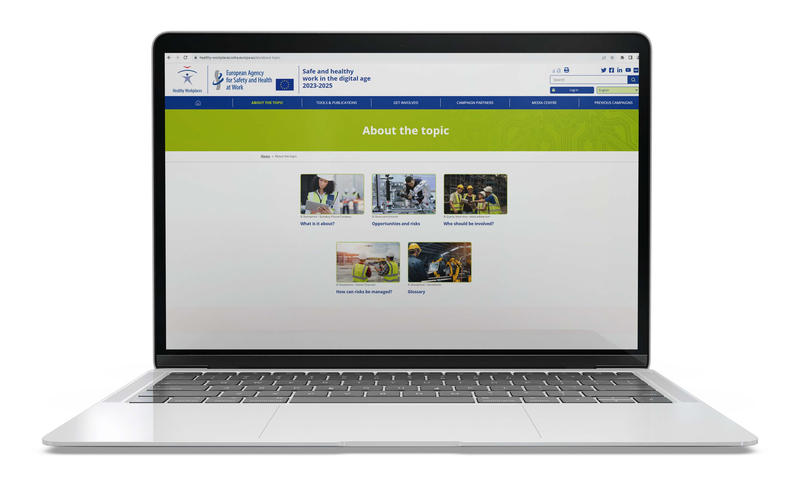
Further information
Check out all related content under priority area “Digital platform work”:
https://healthy-workplaces.osha.europa.eu/en/about-topic/priority-area/digital-platform-work
Consult all publications on the topic:
https://osha.europa.eu/en/publications-priority-area/digital-labour-platforms

Slide 21
Neither the European Agency for Safety and Health at Work nor any person acting on behalf of the agency is responsible for the use that might be made of the following information.
© European Agency for Safety and Health at Work, 2024
Reproduction is authorised provided the source is acknowledged.
For any use or reproduction of photos or other material that is not under the copyright of the European Agency for Safety and Health at Work, permission must be sought directly from the copyright holders.

